Slide 1



Fixit@KPRCAS
Problem Statement ID – PS02
Problem Statement Title – Chatbot for KPRCAS website
Team Name – Auron
Team Leader Name – Dhaarani D
Team Leader Contact – 9159133888
01

Slide 2
AURON
Proposed Solution: Auron – The AI-Powered Guide
Auron is a miniature humanoid robot designed to assist visitors at KPRCAS by providing instant access to college-related information. It integrates a chatbot to offer navigation assistance, multilingual support, and quick query resolution.
Key Features:
Instant Information Access – Eliminates the need to search multiple pages.
Campus Navigation – Guides visitors to classrooms, admin offices, and other key locations.
Interactive Display – Shows chatbot responses on its face and chest screen.
Multilingual Support – Ensures accessibility for all users.
Innovation:
Auron uniquely combines humanoid robotics, chatbot intelligence, and interactive display technology, making visitor engagement more efficient and futuristic.
02

Slide 3
AURON
Idea/Prototype Overview
Auron is a miniature humanoid robot that acts as a smart assistant for KPRCAS visitors, providing navigation, information access, and chatbot-based query resolution through an interactive display.
Technologies Used
Programming: Python (for chatbot), C++ (for hardware control)
Frameworks: TensorFlow (optional AI features), Flask (for web integration)
Hardware: Raspberry Pi, Servo Motors, Touch Display, 3D-printed body
Implementation Methodology
Chatbot Development – Rule-based chatbot trained with college data.
Hardware Assembly – 3D-printed body, motors, and display setup.
Software Integration – Linking chatbot with display & movement controls.
Testing & Deployment – Ensuring seamless interaction and response accuracy.
03

Slide 4
AURON
Feasibility Analysis
Uses readily available components (Raspberry Pi, servos, display).
Rule-based chatbot ensures quick responses without heavy AI processing.
Can be developed within a limited budget using open-source tools.
Potential Challenges & Risks
Hardware Limitations – Movement & display synchronization issues.
Accuracy of Responses – Chatbot may struggle with complex queries.
Power Management – Battery life constraints for continuous operation.
Strategies to Overcome Challenges
Optimize hardware and software for smoother operation.
Implement frequent chatbot updates based on user feedback.
Use a rechargeable battery system for extended uptime.
04

Slide 5
AURON
Team Details
S.No | Team Details | Department | Year of Study | Mobile Number
1 | Team Leader Name | DHAARANI D | I | 9159133888
2 | Team Member 1 | KARTHIKA K | I | 9585050407
3 | Team Member 2 | DHIVYA K | I | 9600607215
4 | Team Member 3 | SASVITH D | I | 9345510364
5 | Team Member 4 | NAVEEN KUMAR V | I | 6380119820
6 | Team Member 5 | NITHIN N | I | 8778595716
S.No | Mentor Details | Department | Mobile Number | Email ID
1 | Mentor 1 (Optional) | Dr. JANANI S | 8220236346 | janani.s@kprcas.ac.in
2 | Mentor 2 (Optional) | Dr. KAVIPRIYA P | 9994180320 | kavipriya.p@kprcas.ac.in
05

Slide 6
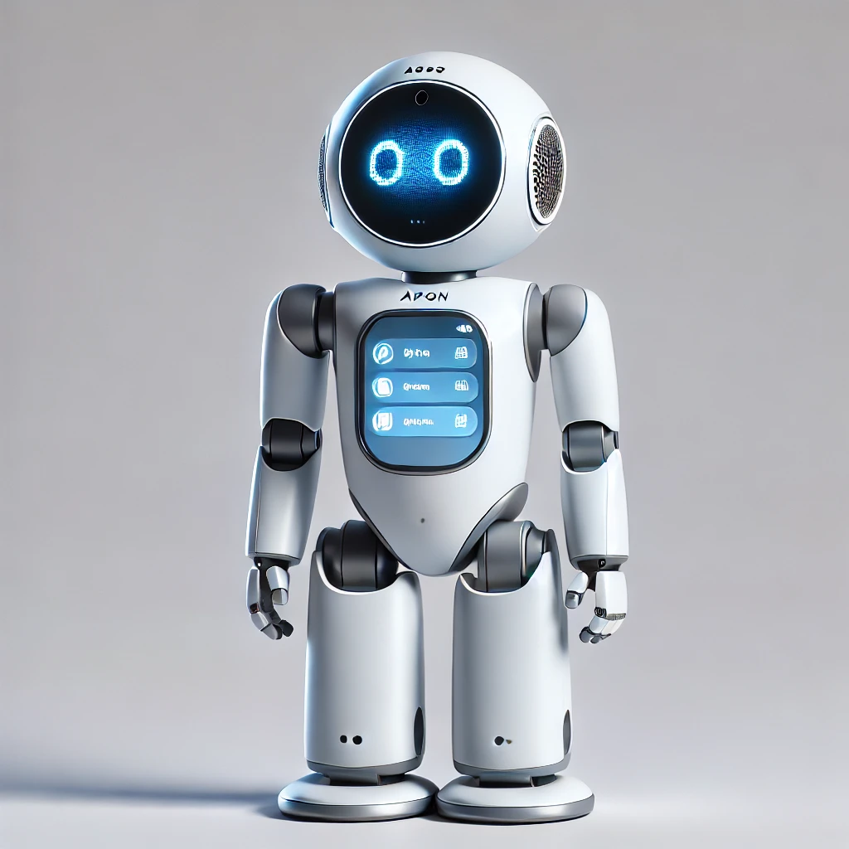
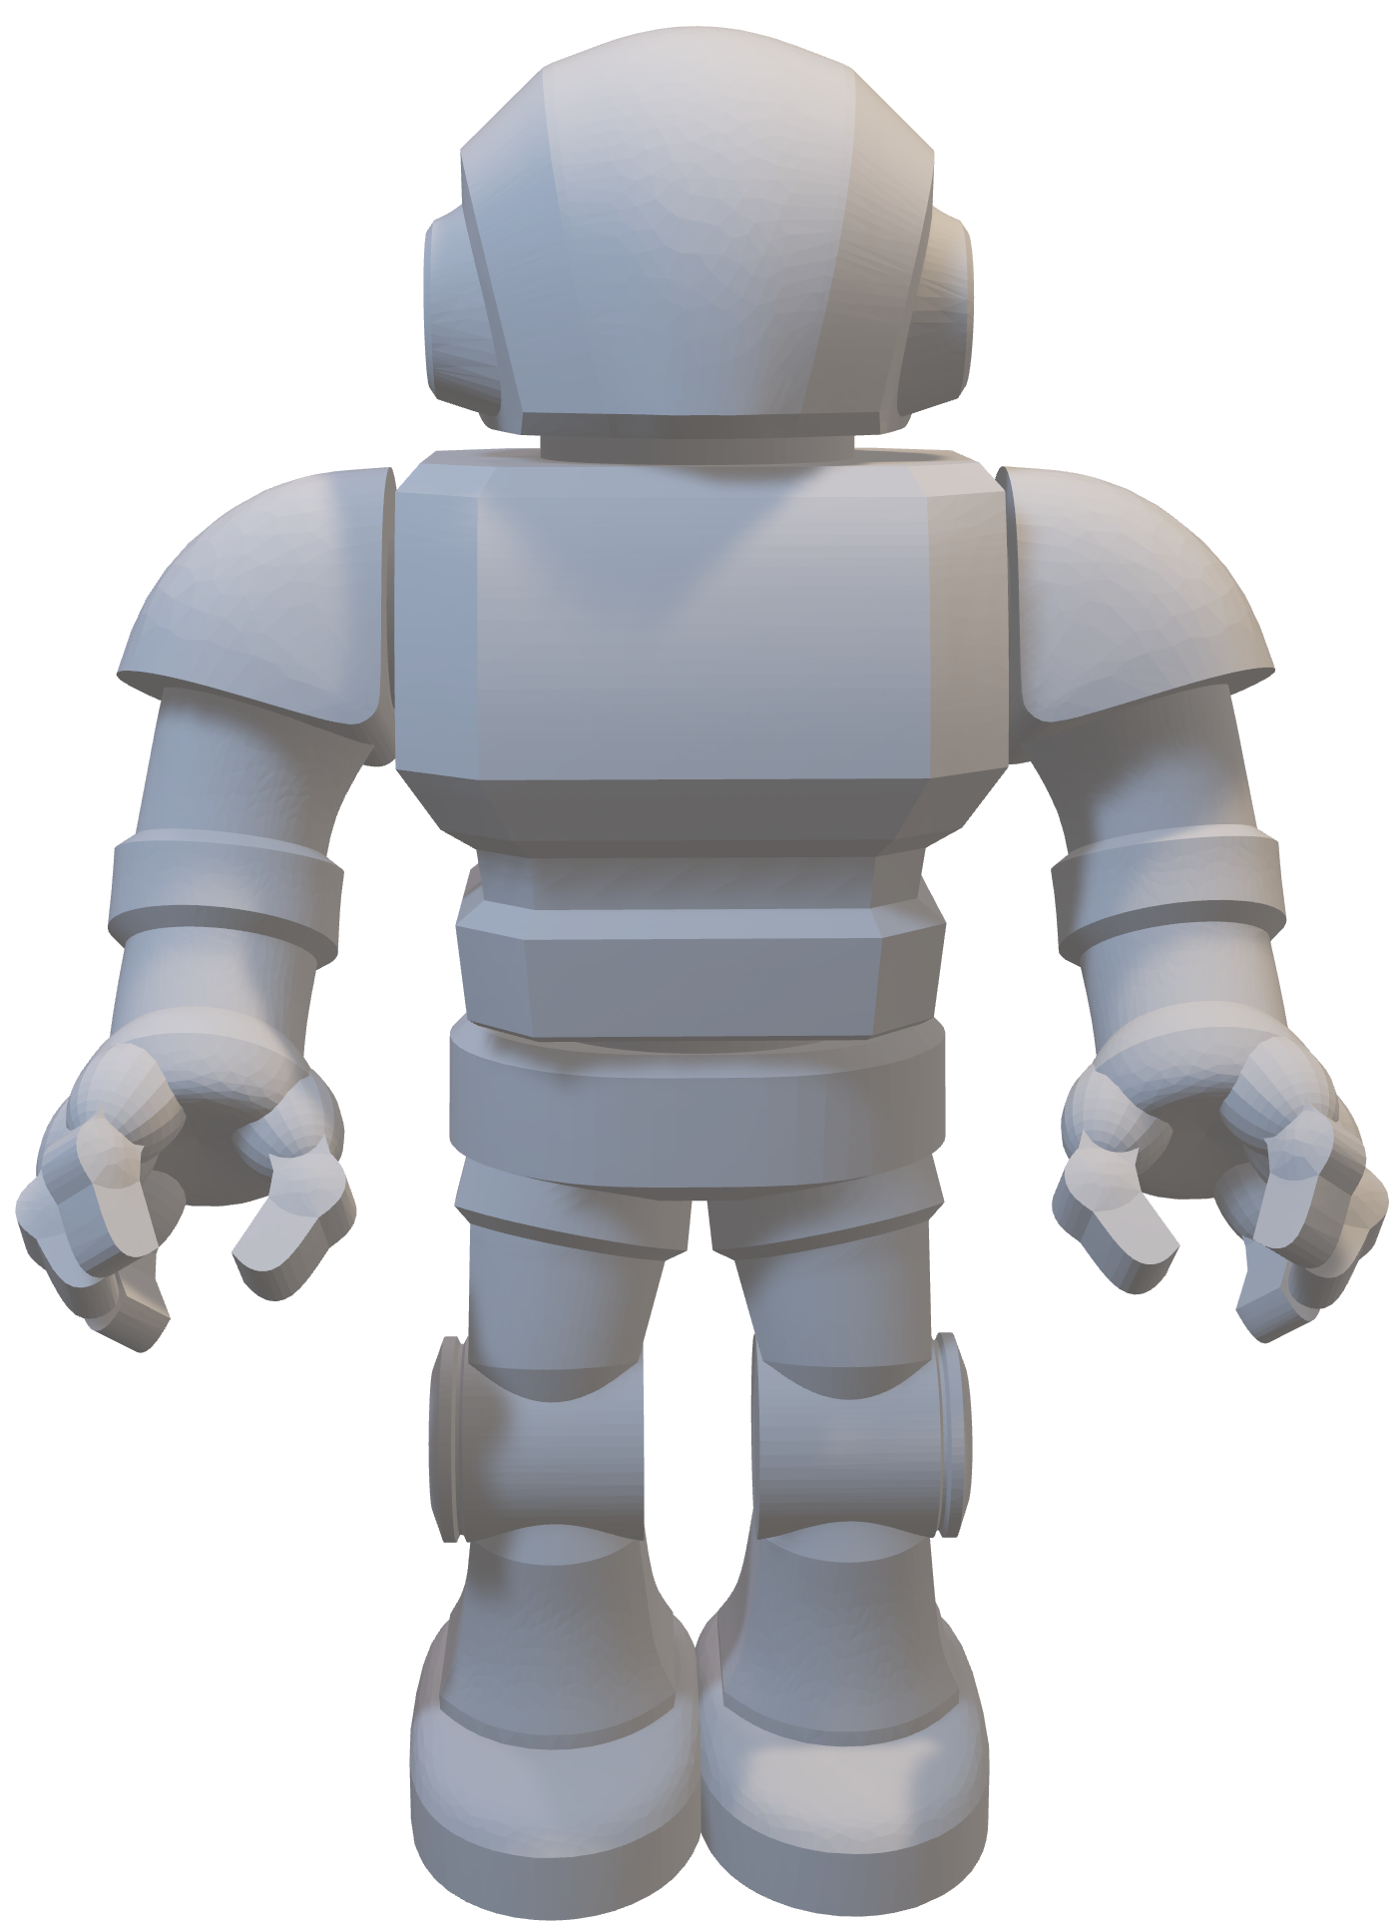
AURON
PROJECT SAMPLE MODEL
05

